Slide 1




ALPHA
HACKTOBERFEST 1.0

Slide 2


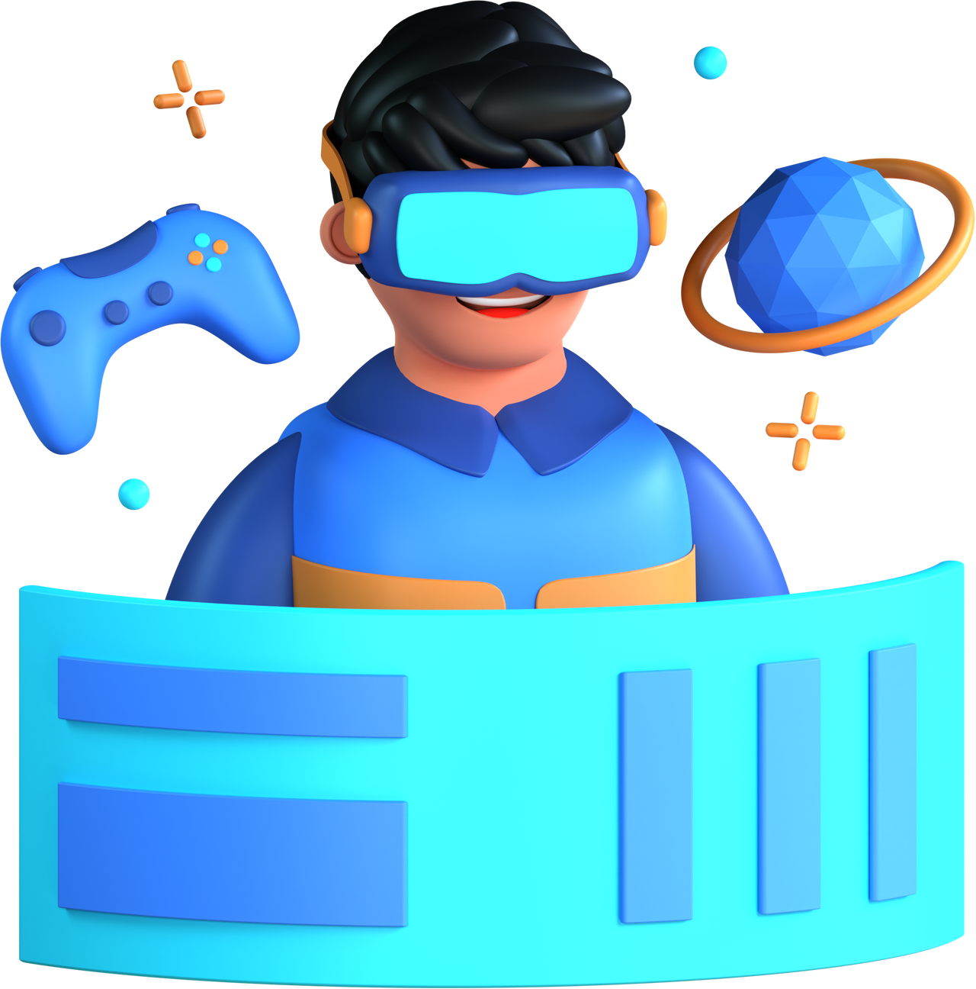



Problem statement
Our business model aims to address the problems of information accessibility, open data utilization, effective communication, and community engagement related to infrastructure and utility issues in the community
In conclusion, creating a platform that enables users to report and track community issues on a map is important and relevant to a broad range of target audiences. It promotes transparency, civic engagement, resource efficiency, and overall community well-being. By addressing these pressing problems and fostering collaboration, your platform can have a positive and lasting impact on the society it serves

Slide 3




Solution
A Mobile Website that gives informations of various Problems like Water, Electricity, Sewer from around the Community, Open Source Data etc. And Display them a Map. Looking Forward to Seek other Features also which can be helpful for the Society. AND save the time of the recidents so that they can solve their problems in a single step .

Slide 4


Key Features and Functionality
Our main key features of our website was to give a good user face interface and to provide the coustamisabe settings to the users which will help them in their upcoming days and it will be more simple so that the old people can also access this web site so easily

Slide 5


Social impact
This helps the people in the community to solve their problems in one step where the community people will resolve their issue as fast as they can and this will be decrease the problem solving time as well . And everyone can be individuals and no need to depend up on anynone .

Slide 6

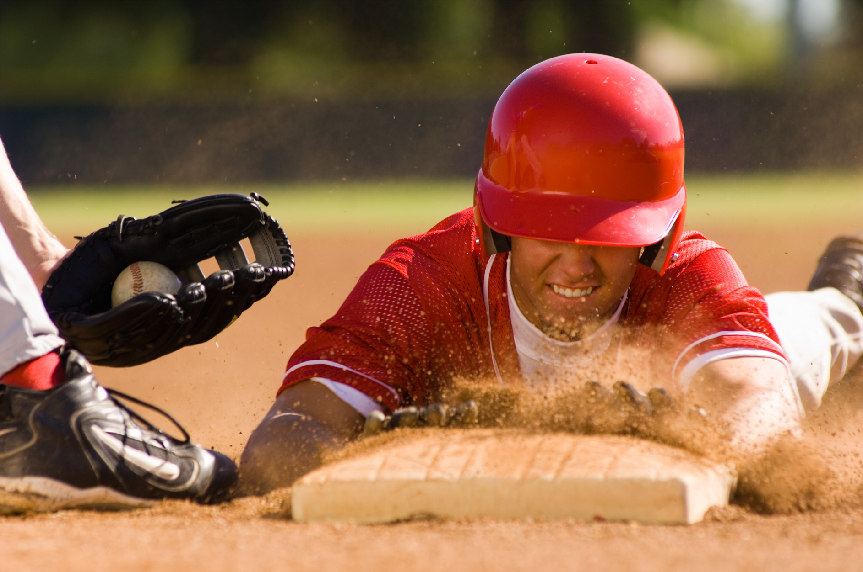
Revenue Model
OUR REVENUE MODEL WAS TO CHARGE A LIMITED AMOUNT FROM EVERY RECIDENT IN THE COMMUNITY AND WE WILL PROVIDE SOME COUPONS TO THE RESIDENTS WHICH THEY CAN USE IN THE COMMUNITY STORES

Slide 7


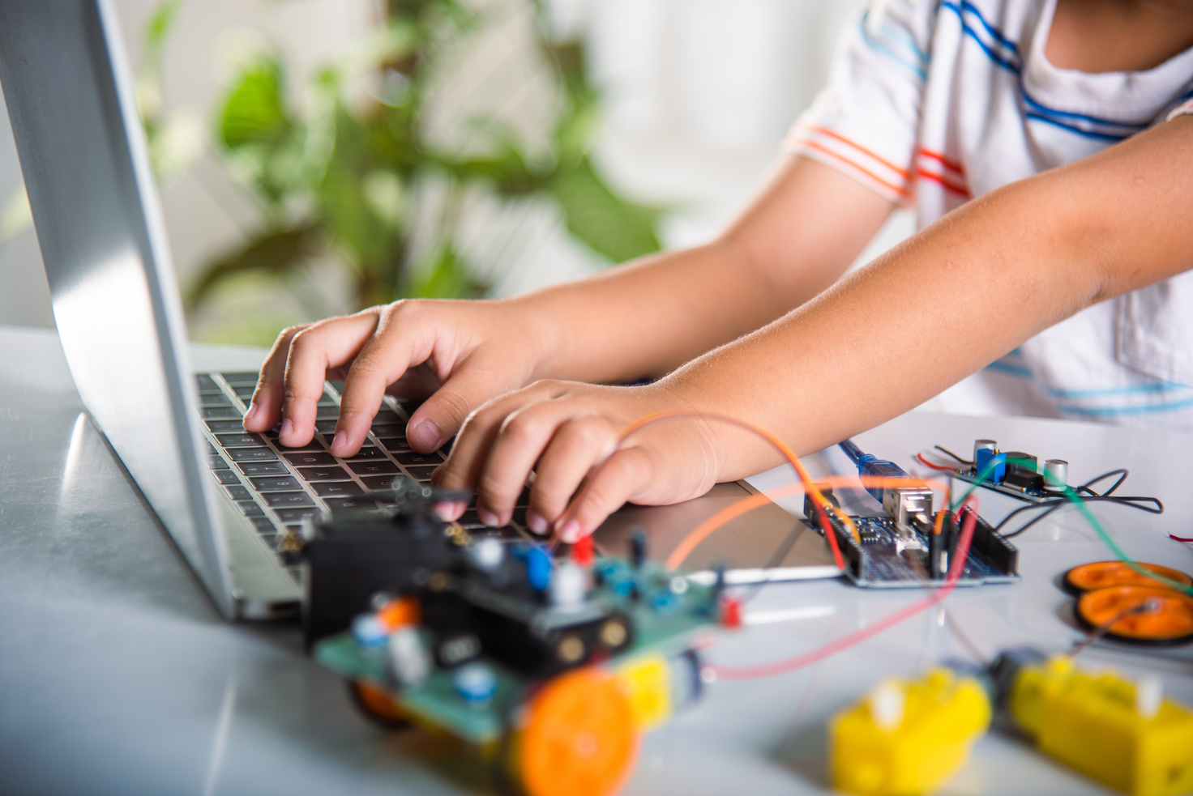
Technologies Used
OUR TEAM UTILIZED A VARIETY OF TECHNOLOGIES INCLUDING PROGRAMMING LANGUAGES LIKE JAVA SCRIPT AND HTML CSS,WHICH WERE USED TO DEVOLOPE THEWEBSITE.

Slide 8

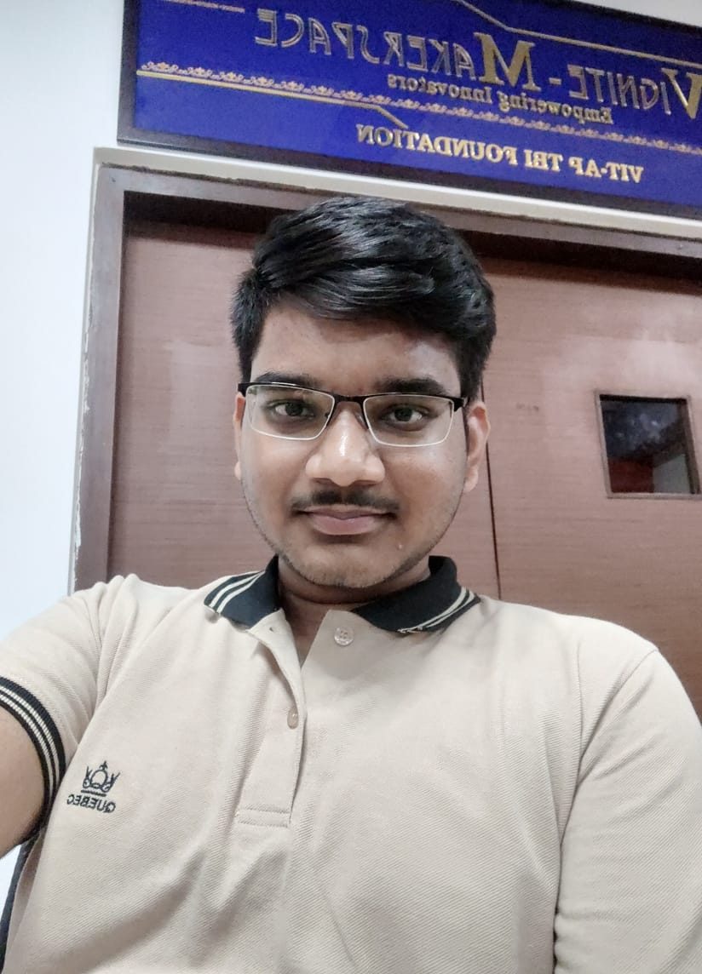
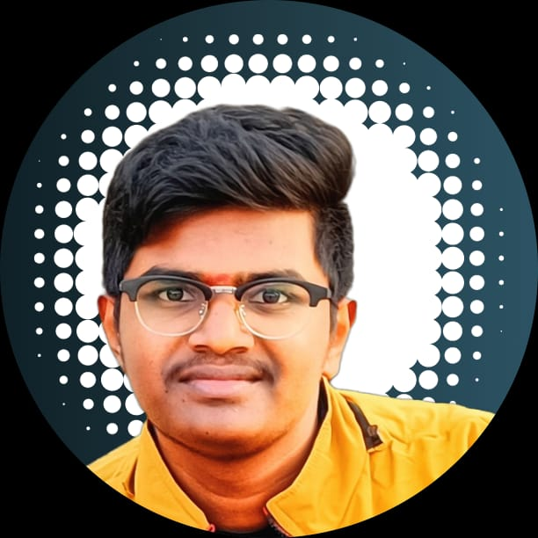
The Team
Abdul
Mannaan
Ch.Sai
Tharun
Team Member
Team Member

Slide 9


Thank You
HACKTOBER FEST

